Slide 1
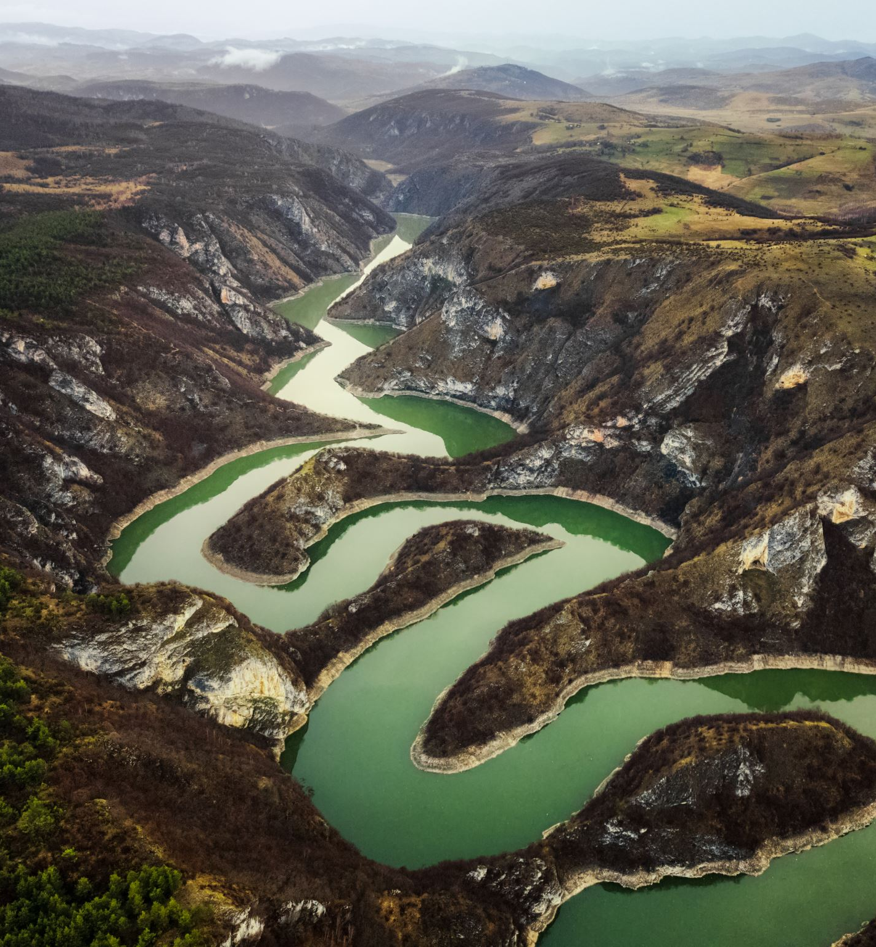
LSTM Reservoir Modeling
Progress Report 1/24/24

Slide 2

Contents
Modeling Shasta Reservoir
Model configuration and performance
Do cell states reflect storages?
How does performance change with time?
R2 on rolling and sliding windows
Do other reservoirs have the same pattern?

Slide 3

Modeling Shasta Reservoir: Model Configuration and Performance

Slide 4
Data Summary
Data Processing
Data from 01-01-1944 to 12-31-2022
Daily resolution data
Model input timeseries: inflow (average daily cfs) and day of year (DOY)
Model output timeseries: reservoir releases (average daily cfs)
60% Train, 20% Validation, 20% Test split
Standardize (or normalize) data using training data stats
Fill nan values using training mean
Reshape data into 3-year chunks (pad remainder)
Padded values are ignored by the loss function and do not affect training or evaluation
Final shape (# chunks, chunk size, # features)

Slide 5

Transformations
Loss Functions
Standardization transforms training data so it has mean 0 and stdev 1
$z= \frac{x_{i}−\overline{x}}{\hat{σ}}$
Normalization transforms training data so it has range between 0 and 1
$z= \frac{x_{i}−x_{min}}{x_{max}−x_{min}}$
Mean Square Error (MSE)
Root Mean Square Log Error (RMSLE)
RMSLE results in less penalty on peaks

Slide 6
Different Model Architectures
MODEL 1
Standard LSTM
MODEL 2
Autoregressive LSTM
MODEL 3
LSTM with Implied Storage
[predicted release]
[predicted release]
[predicted release]
Single-layer FF
Single-layer FF
Single-layer FF
n-layer LSTM
n-layer LSTM
n-layer LSTM
storage_{i} =
storage_{i-1} – release_{i} + inflow_{i}
[inflow, DOY]
[inflow, DOY]
[inflow, DOY]

Slide 7
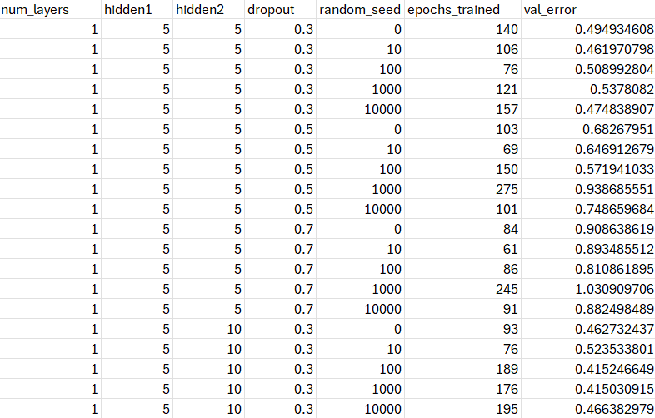
Hyperparameter Tuning
Exhaustively search a grid of predefined hyperparameters (Grid Search)
Number of LSTM layers
Size of LSTM hidden layer
Size of FF hidden layer
Dropout probability
5 different random seeds
Choose model with the best validation performance (averaged over random seeds)
Model 1 (fastest to train) uses the largest grid
Other models searched over reduced grid

Slide 8
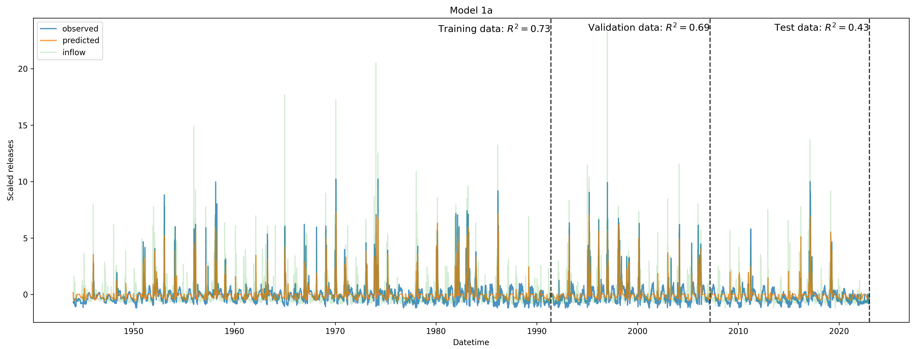
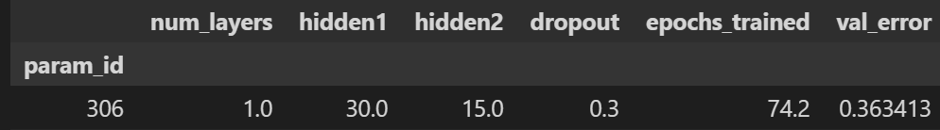
Model 1(a): Standardized, MSE Loss

Slide 9
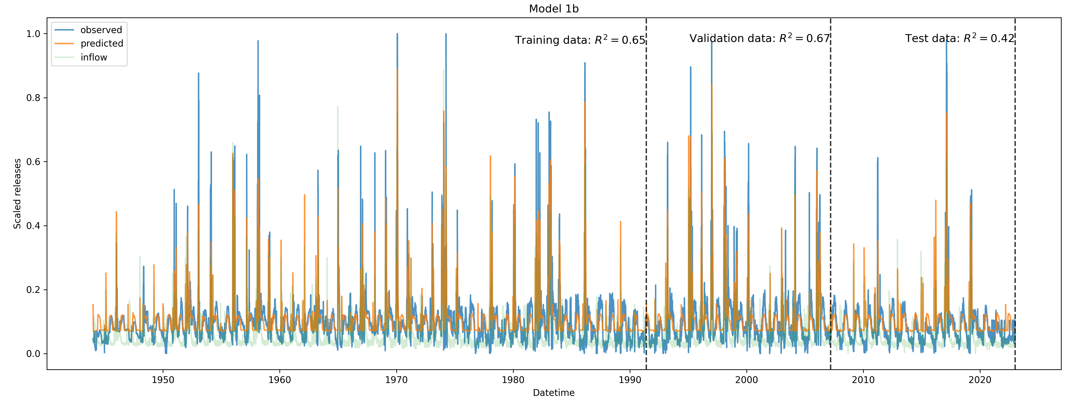
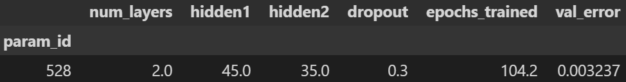
Model 1(b): Normalized, MSE Loss

Slide 10
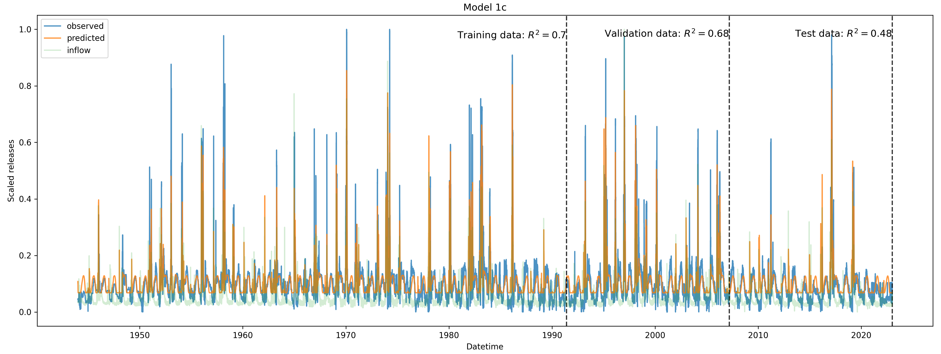
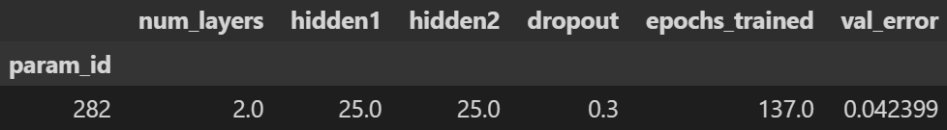
Model 1(c): Normalized, RMSLE Loss

Slide 11
Takeaways from Model 1
Performance is decent out of sample (validation) with R2 ~0.7
Model learns to release peaks corresponding to inflow peaks (leading to some “phantom” peaks)
Differences in validation performance between loss functions and transformations are negligible
Test performance is much worse than training or validation – nonstationarity in hydrology or policy?

Slide 12
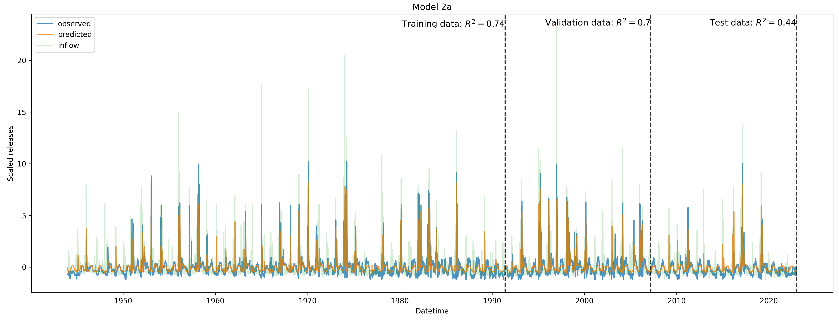
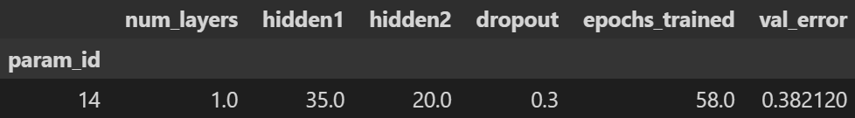
Model 2(a): Standardized, MSE Loss

Slide 13
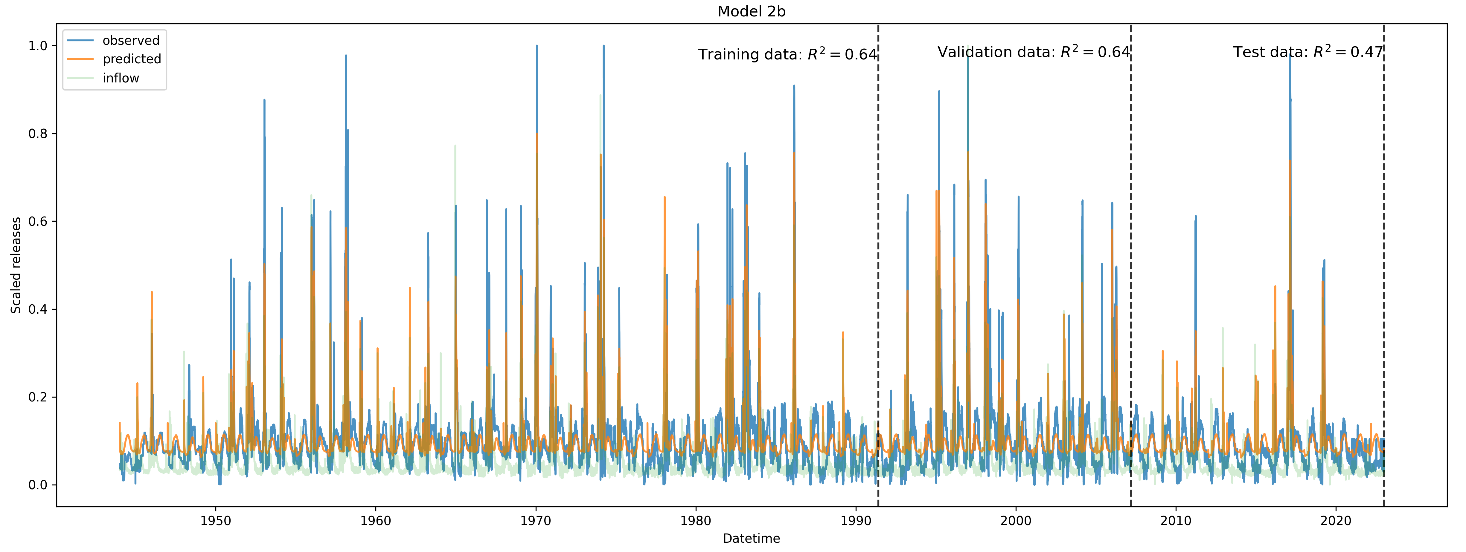
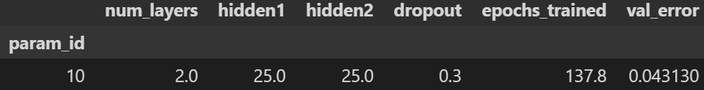
Model 2(b): Normalized, RMSLE Loss

Slide 14
Takeaways from Model 2
Model 2 does not appreciably outperform Model 1
Model still learns to release peaks corresponding to inflow peaks
Model(a) does slightly better than model (b). Still may not be very sensitive to loss/transformation
Test performance is still much worse than training or validation

Slide 15
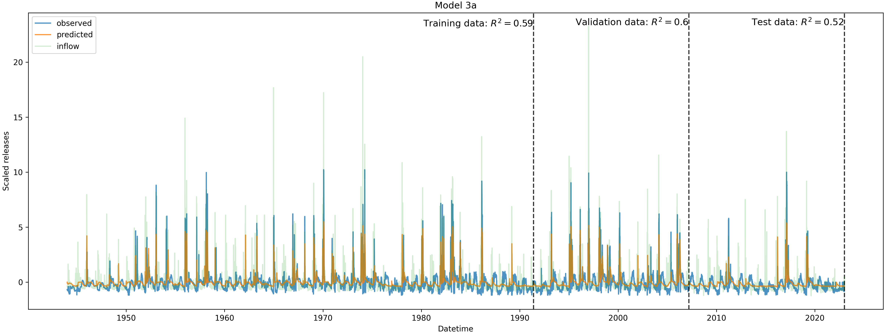
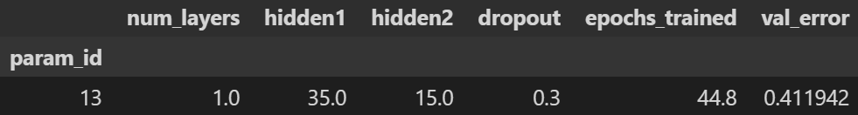
Model 3(a): Standardized, MSE Loss

Slide 16
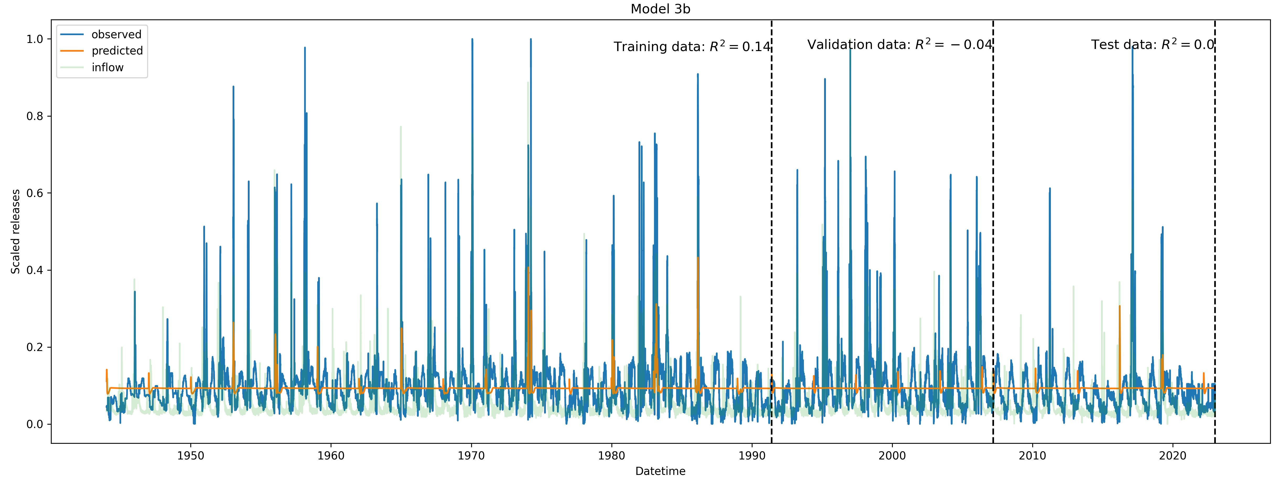
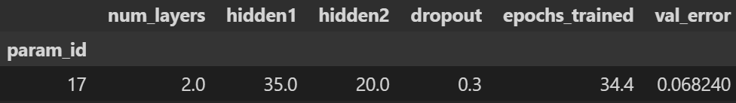
Model 3(b): Normalized, RMSLE Loss

Slide 17
Takeaways from Model 3
Model 3a slightly underperforms Model 1 and 2. Seasonal releases more underpredicted than other models.
Despite maintaining implied storage, model still learns to release peaks corresponding to inflow peaks
Model is very sensitive to choice of loss and data transformation. Model 3b fails to train properly – perhaps finding a very suboptimal local minimum
Test performance is still worse than training/validation

Slide 18
Modeling Shasta Reservoir: LSTM Cell States vs Storage

Slide 19
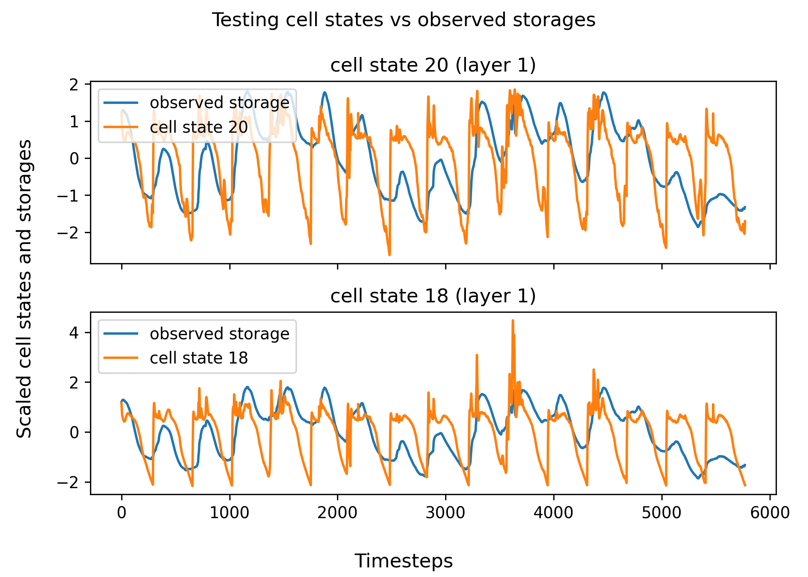
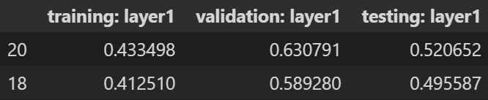
Model 1a
First, select cell states with absolute value of correlation coefficient > 0.4 (in training)
Plot scaled storage and cell states
The highest correlated cell states with storage learn the seasonality of storages but not the values of storage themselves
It is possible that storages are represented through complex interactions of many cell states – even if true this is not interpretable

Slide 20
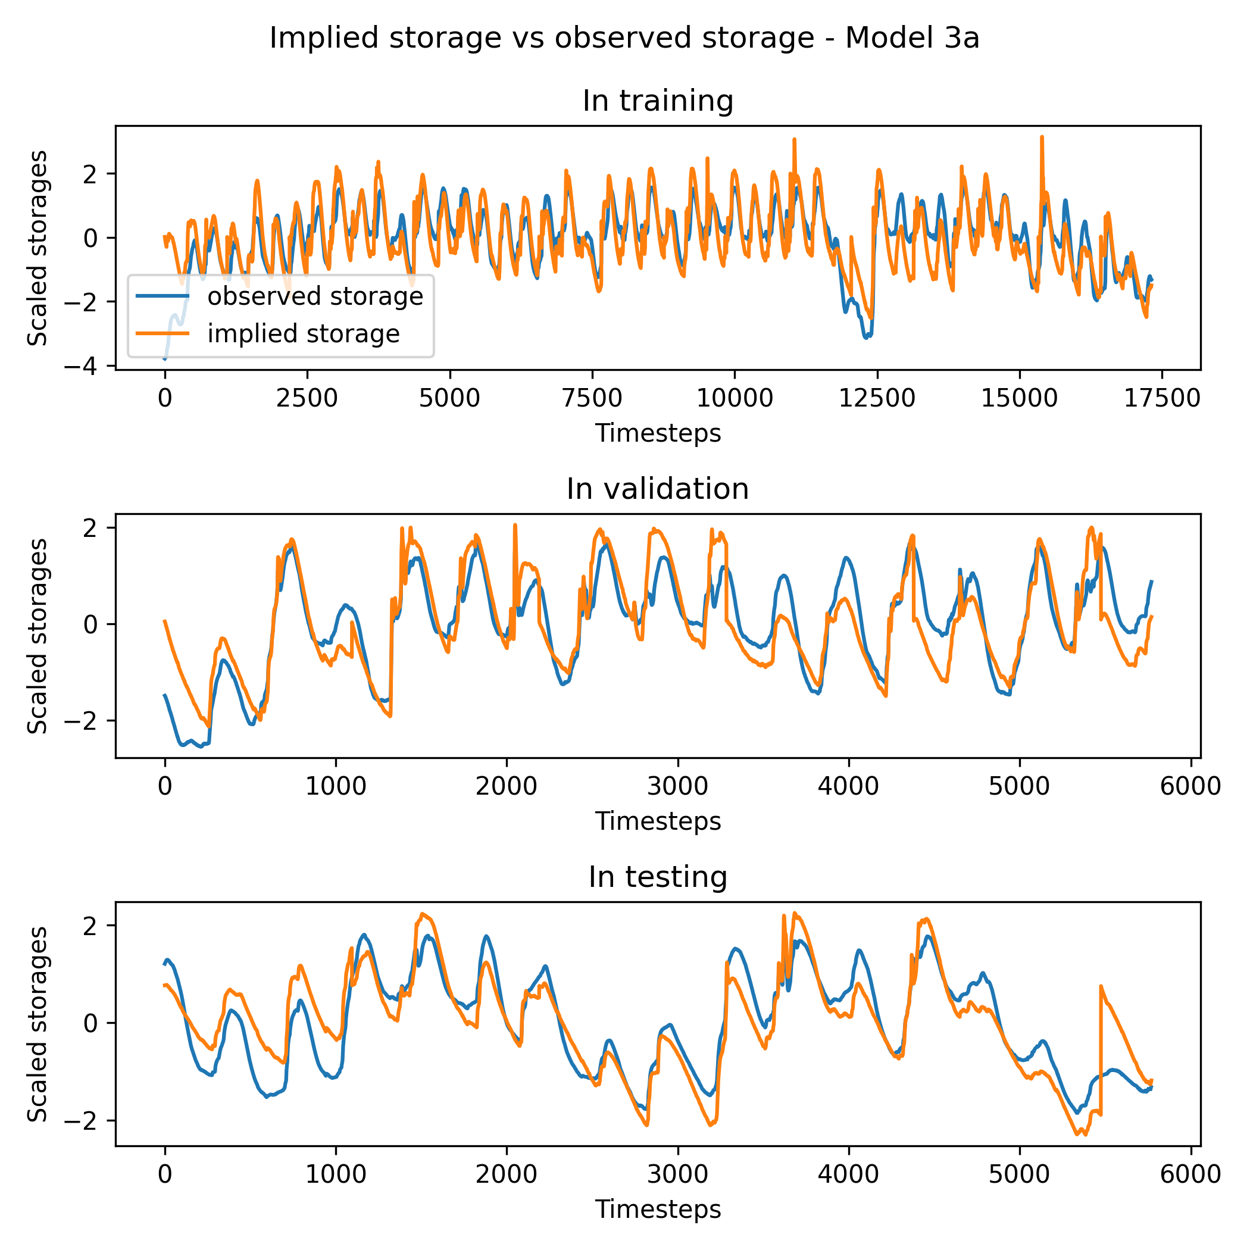
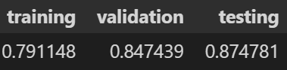
How about the implied storages from Model 3a?
The implied storages from Model 3a capture true storage very well and are also highly correlated with true storage
Interesting to see Model 3a underperform Model 1a

Slide 21
Changing Performance with Time: Model Performance on Moving Windows

Slide 22
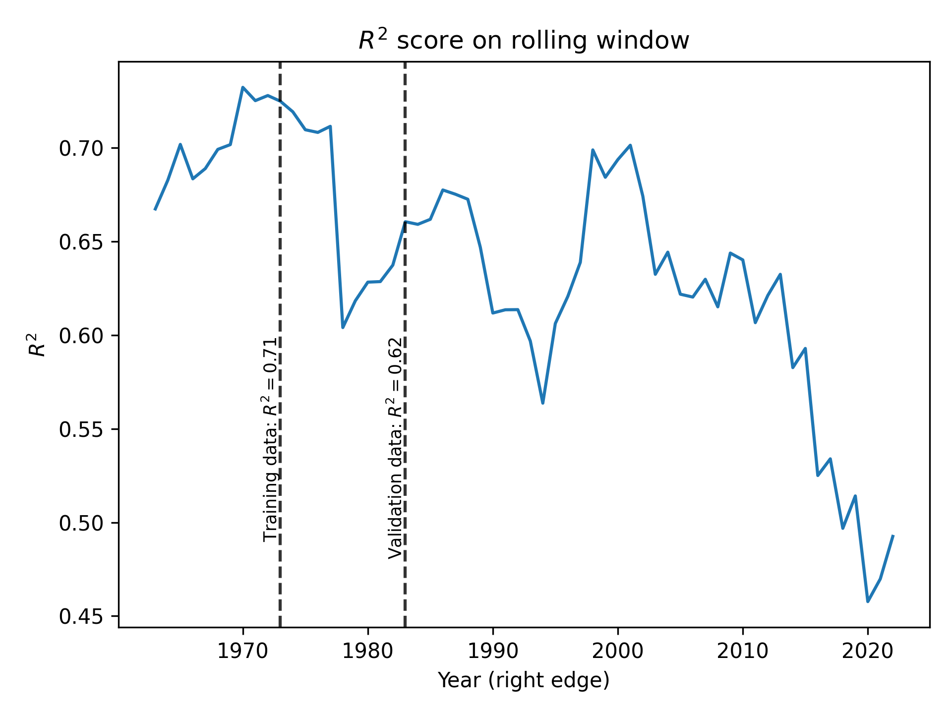
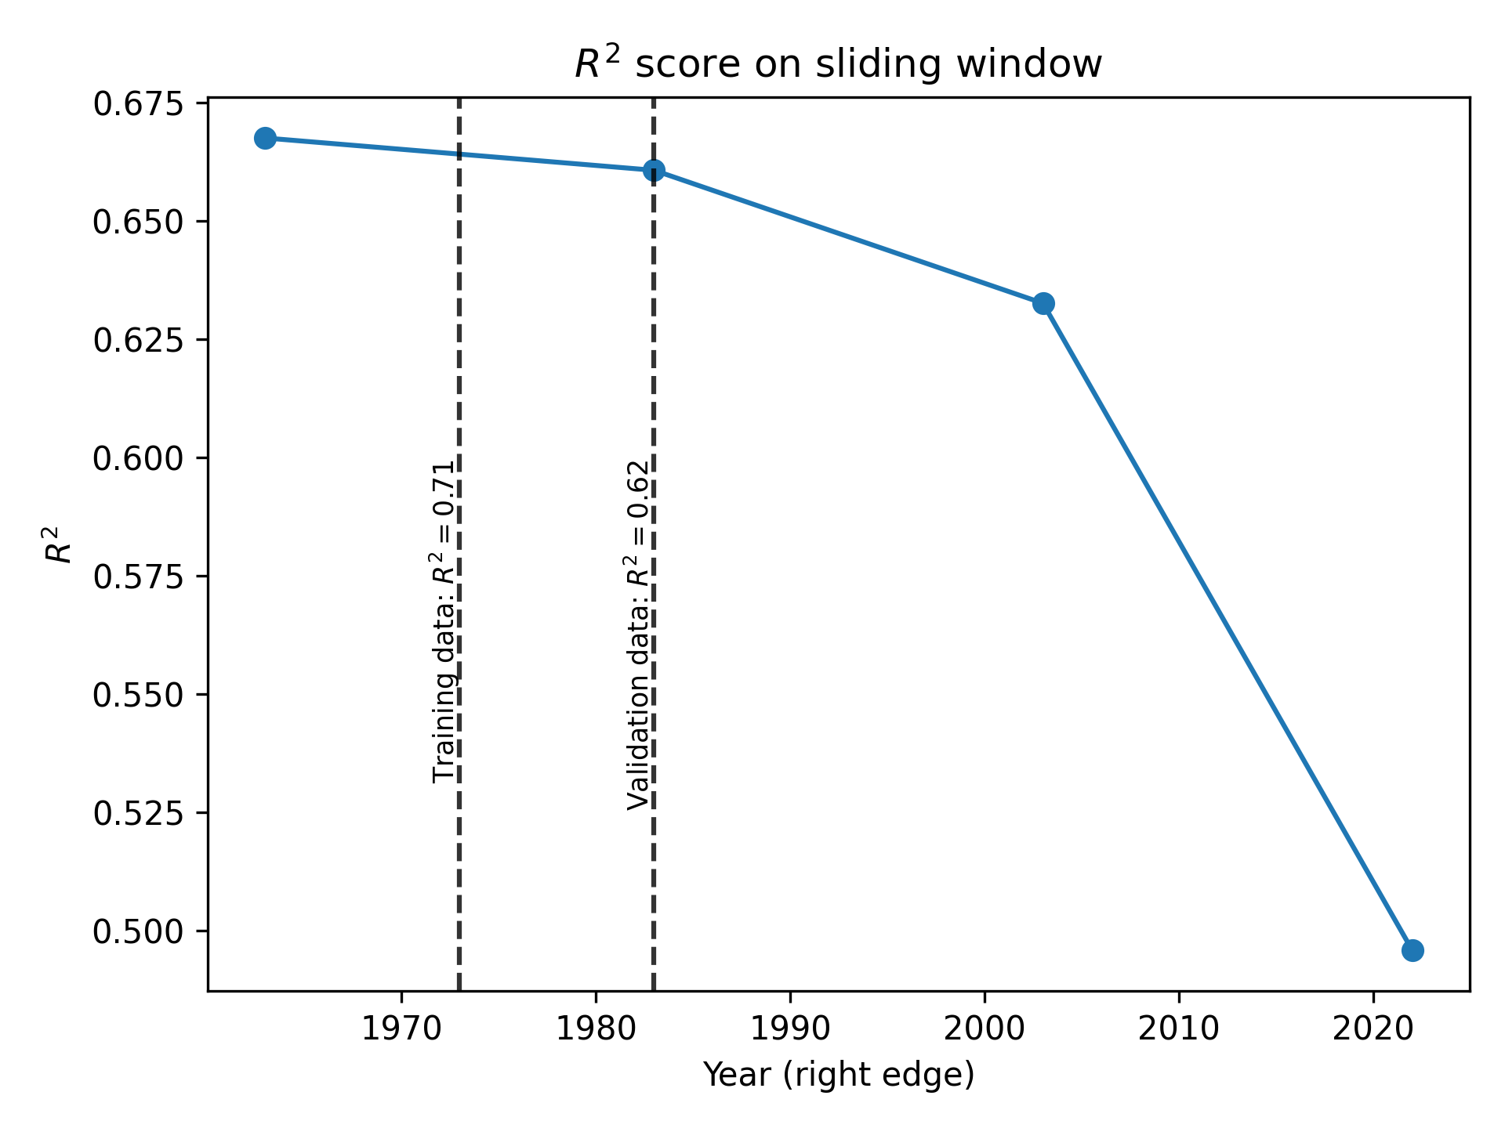
Moving Windows
In previous results, we see that test performance is much lower than training or validation performance
Decline in performance could be driven by overfitting, changes in hydrology, or changes in policy
Idea: train a model on initial window (first 30 years training, next 10 years validation) and track performance over rolling and sliding windows
Initially, used Model 1a architecture on Shasta with manually tuned hyperparameters. This initial model achieves 0.71 R2 in training and 0.62 R2 in validation – similar to the original Model 1a
Overall clear that performance severely declines with time. From moving windows plot, also clear that model performance is sensitive to natural variability
From sliding windows plot, some evidence of overfitting after training and validation, but overfitting does not explain the continual decline in performance

Slide 23
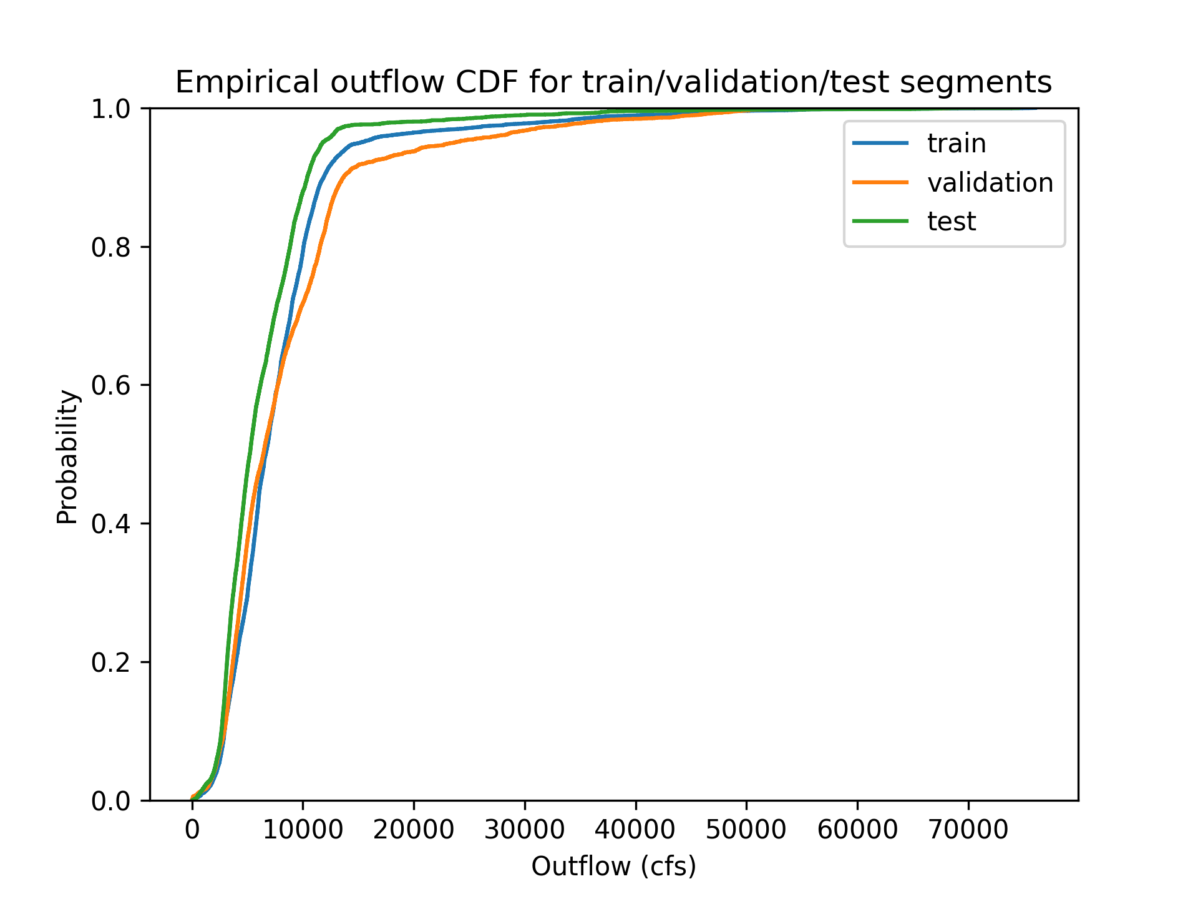
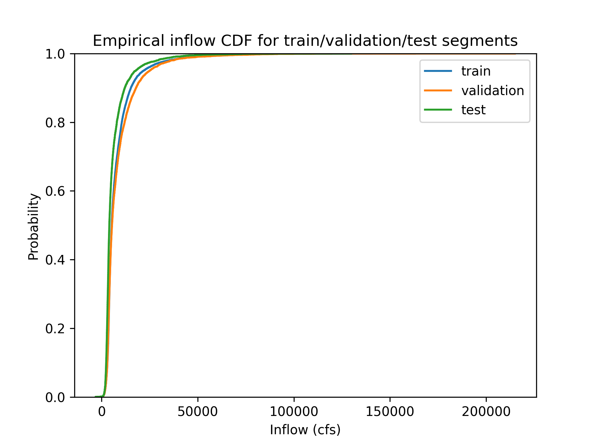
Changing Hydrology
There is an evident difference in distribution between train/val/test segments for hydrology (observed inflow)
The same pattern holds for observed outflow as well

Slide 24
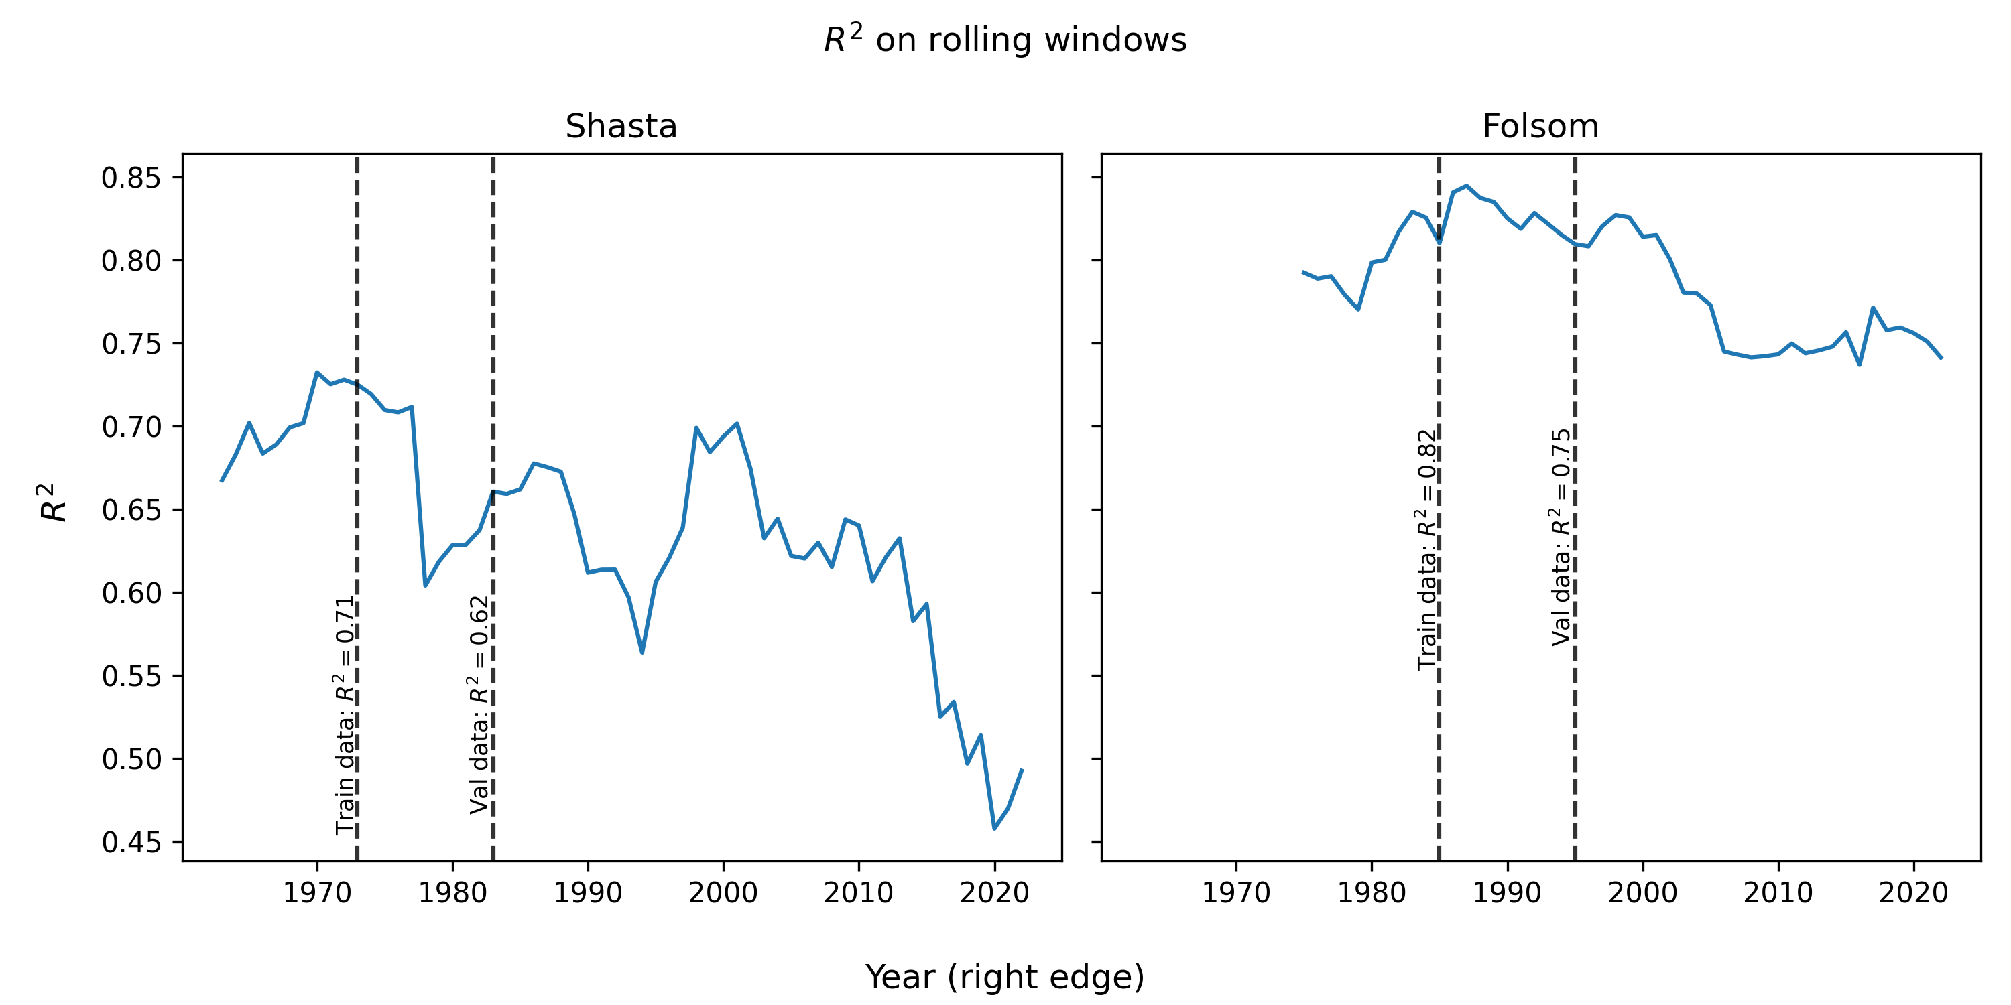
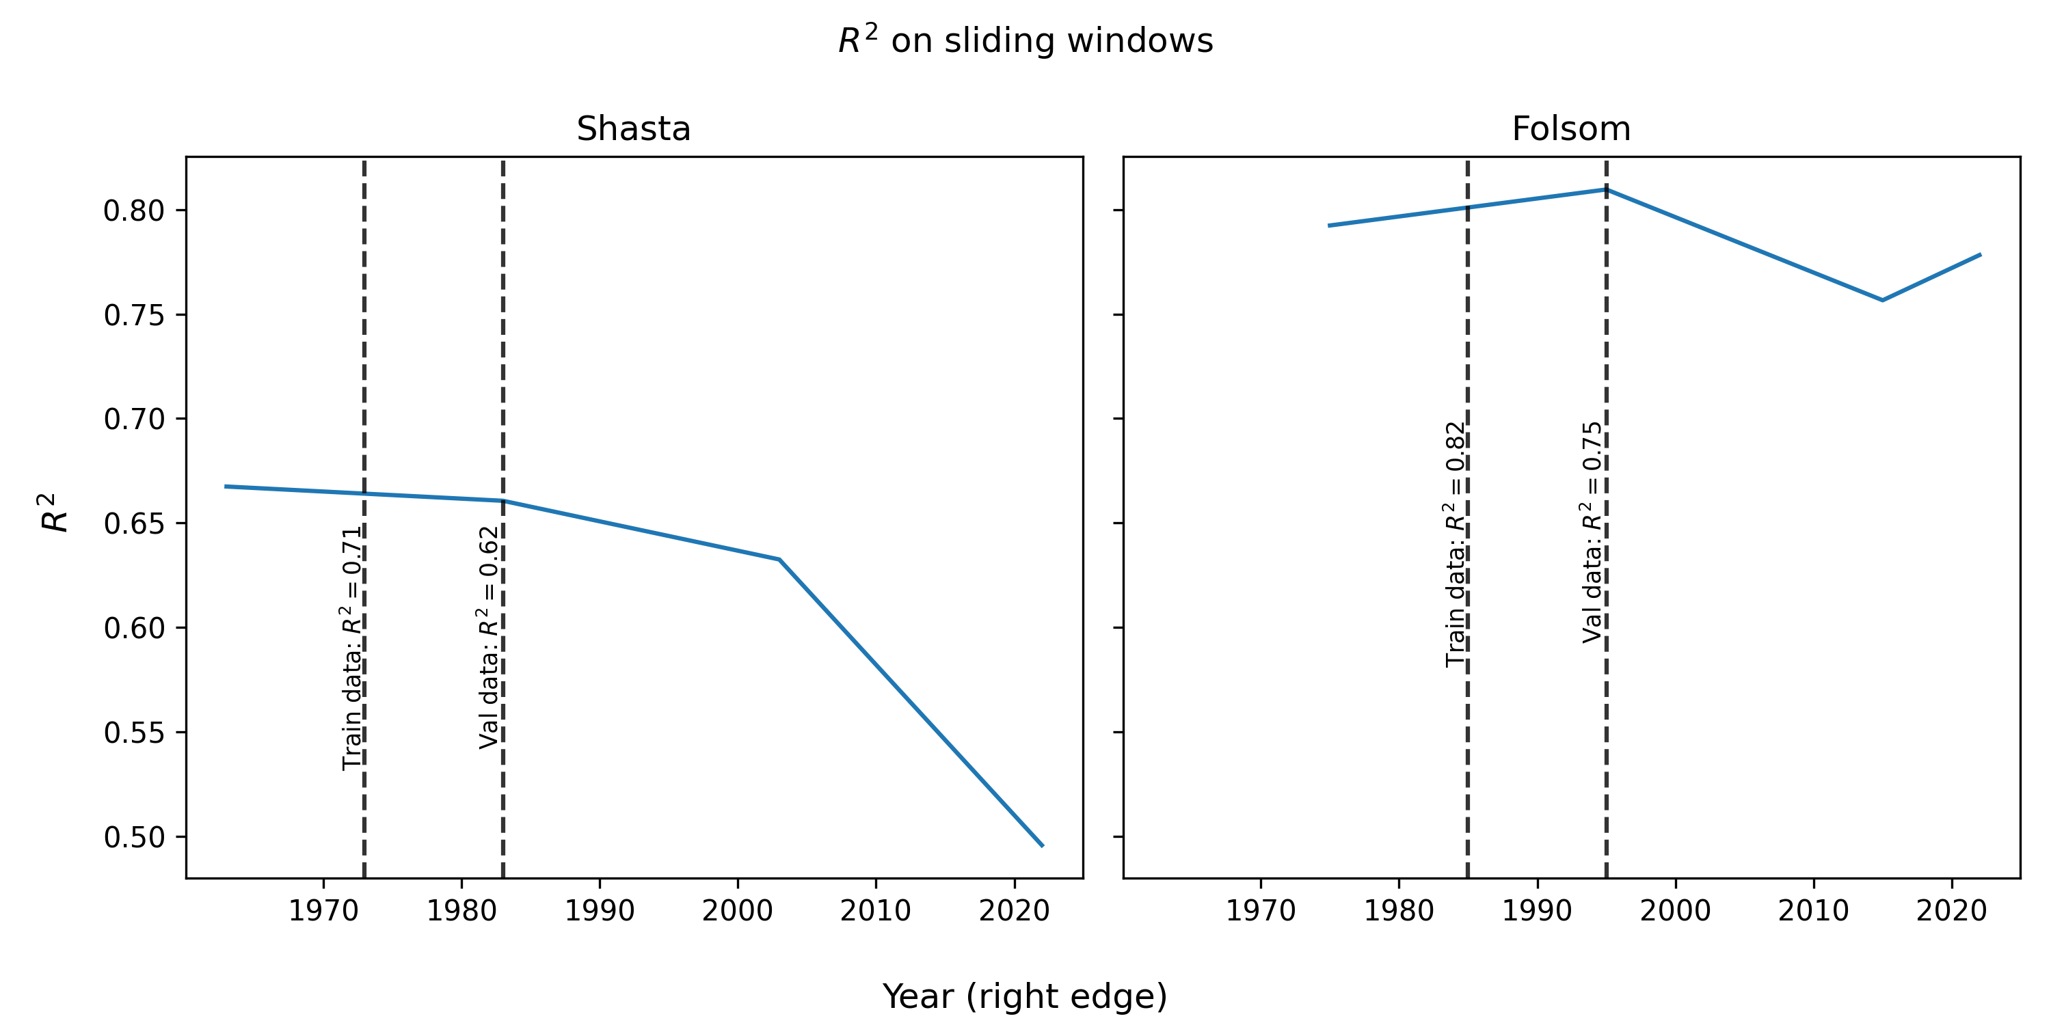
Does the same pattern hold for other reservoirs?
Repeating the same experiment for Folsom, the results are completely different
There may be some evidence of overfitting (decline in performance after training/val), but stabilizes afterwards

Slide 25

Future Questions and Experiment Ideas
Performance changes differently with different reservoirs: try more reservoirs! Why does this happen?
How often should models be retrained (model maintenance)? Simulate performance after retraining every x years
How much training data should we use? More training history = more stable training, less sensitive to noise, potentially better accuracy. Less history = more sensitive to changes in policy, cheaper to train
Training on multiple reservoirs at a time (even if they are operated differently) and see what information is learned

